Slide 1

Product redistribution

Slide 2
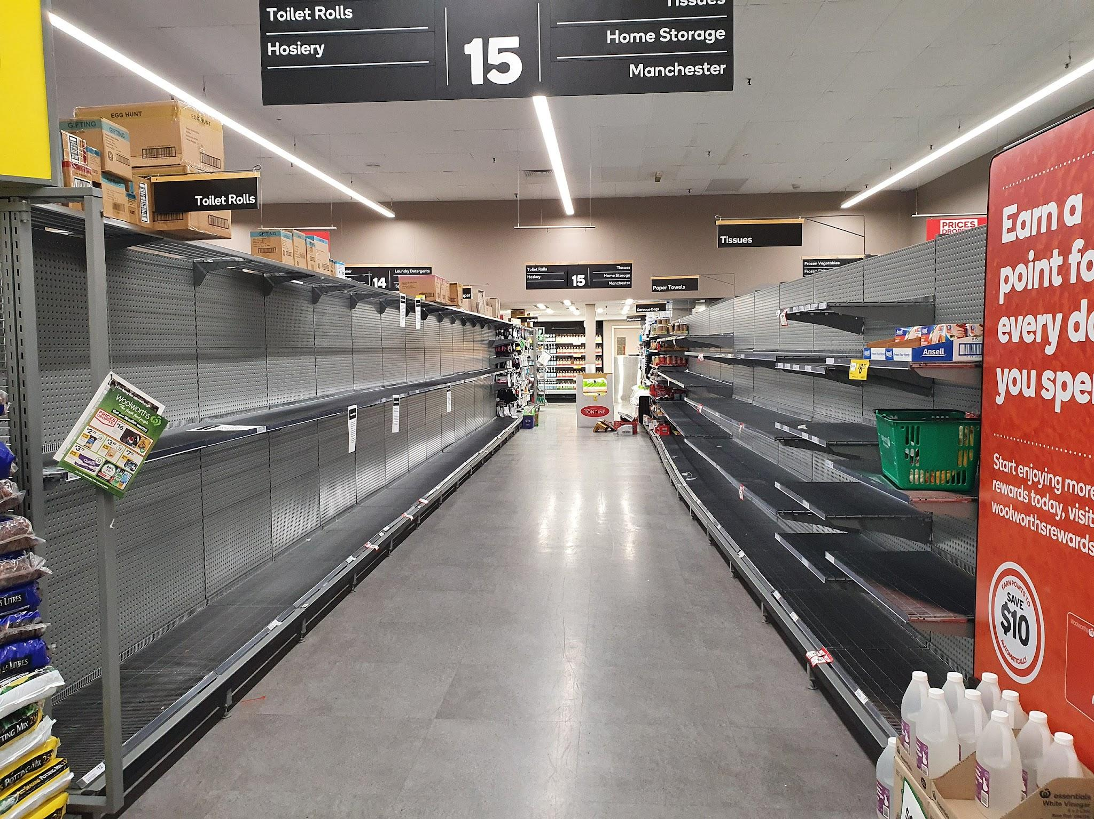
THE PROBLEM

Slide 3
CONSEQUENCES
Frustrated customers & employees
High workload
Avoidable costs & CO2 emissions

Slide 4
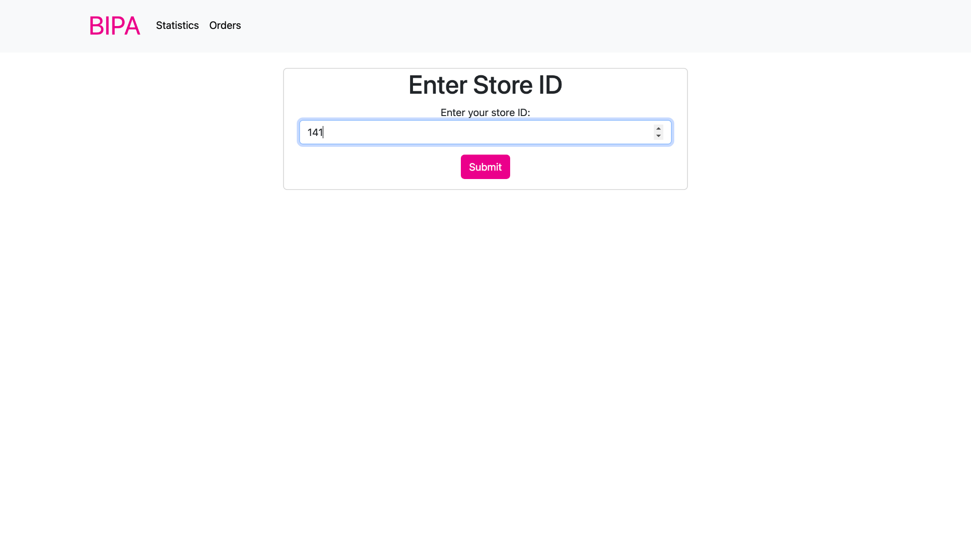

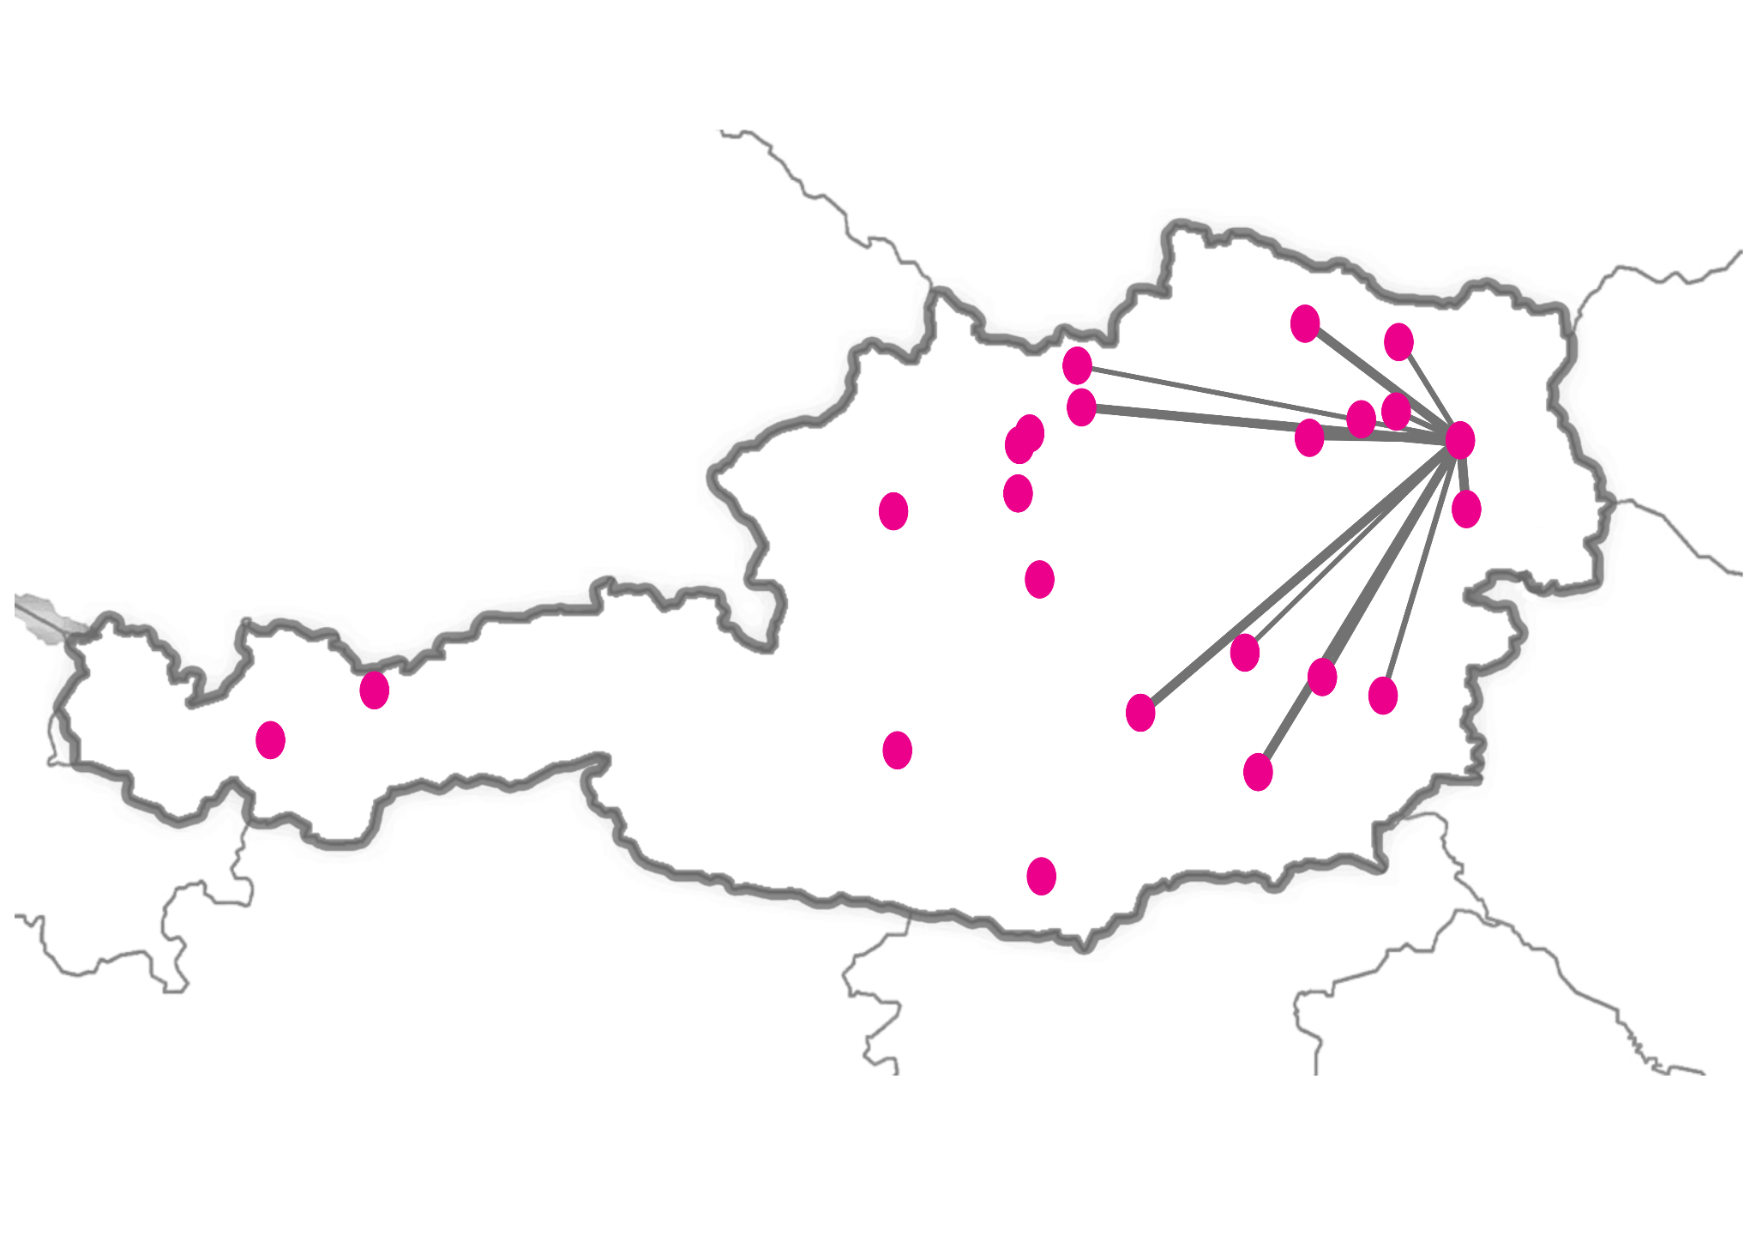
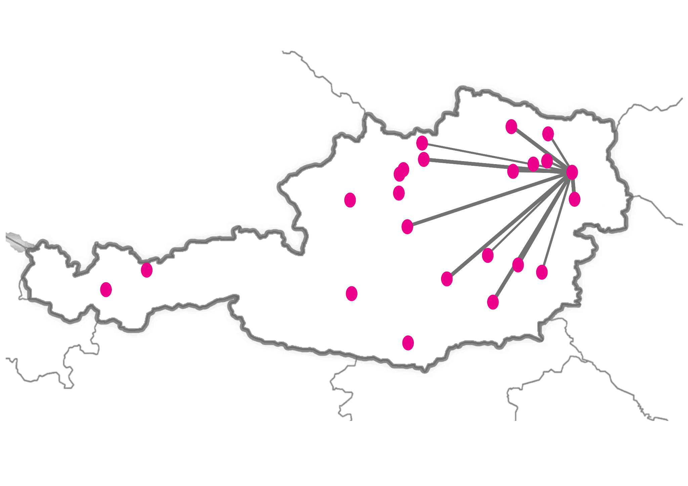
MATCH SUPPLY WITH DEMAND
Notes:
We match stores with our blazing fast algorithm and present the list of orders in a user friendly way

Slide 5
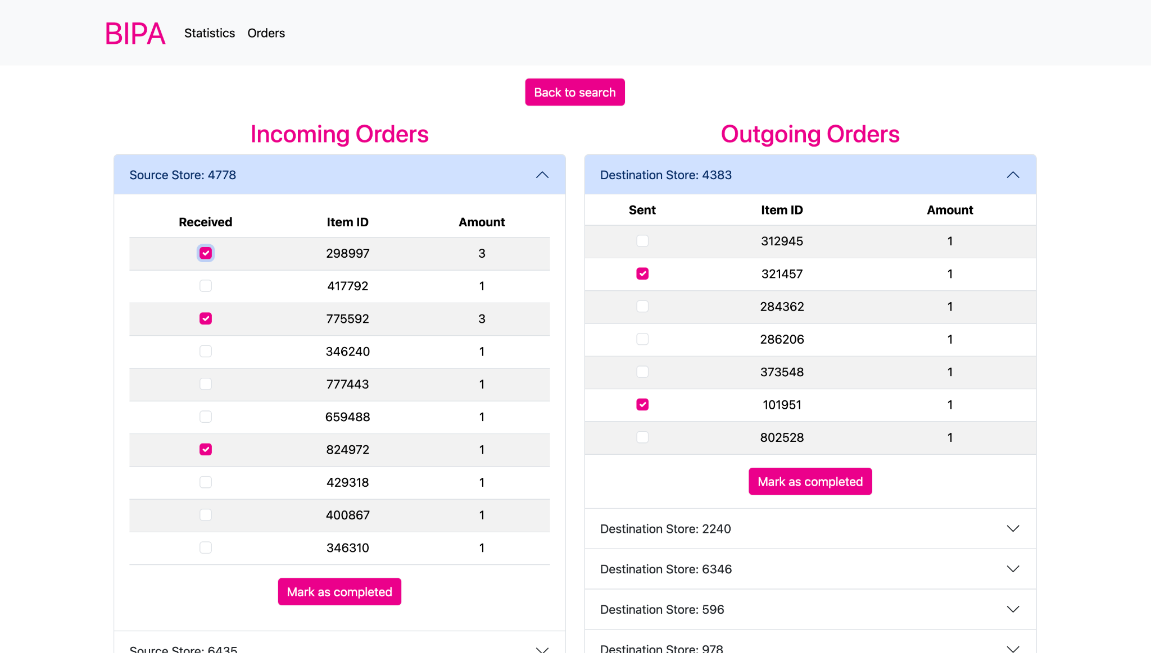
PERSONALIZED INSTRUCTIONS
Notes:
We match stores with our blazing fast algorithm and present the list of orders in a user friendly way

Slide 6
OPTIMIZED REDISTRIBUTION
reduced understock by:
61%

Slide 7
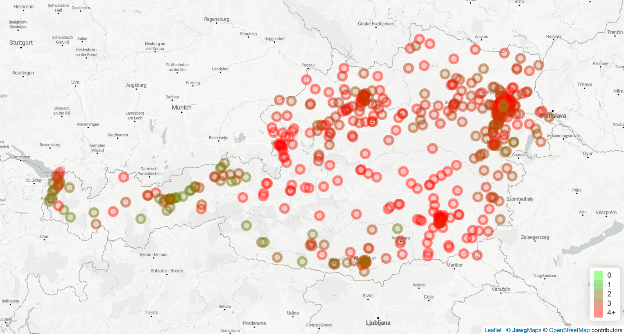
OPTIMIZED REDISTRIBUTION

Slide 8
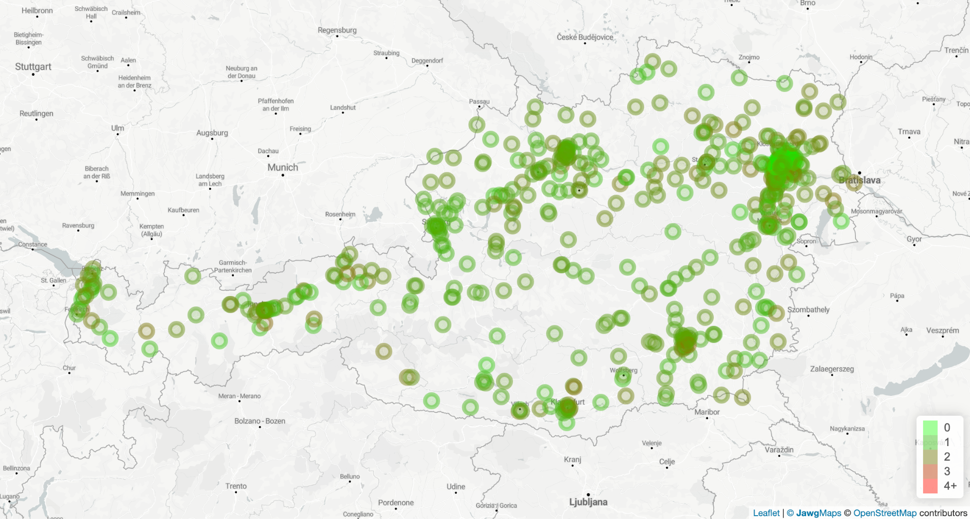
OPTIMIZED REDISTRIBUTION

Slide 9
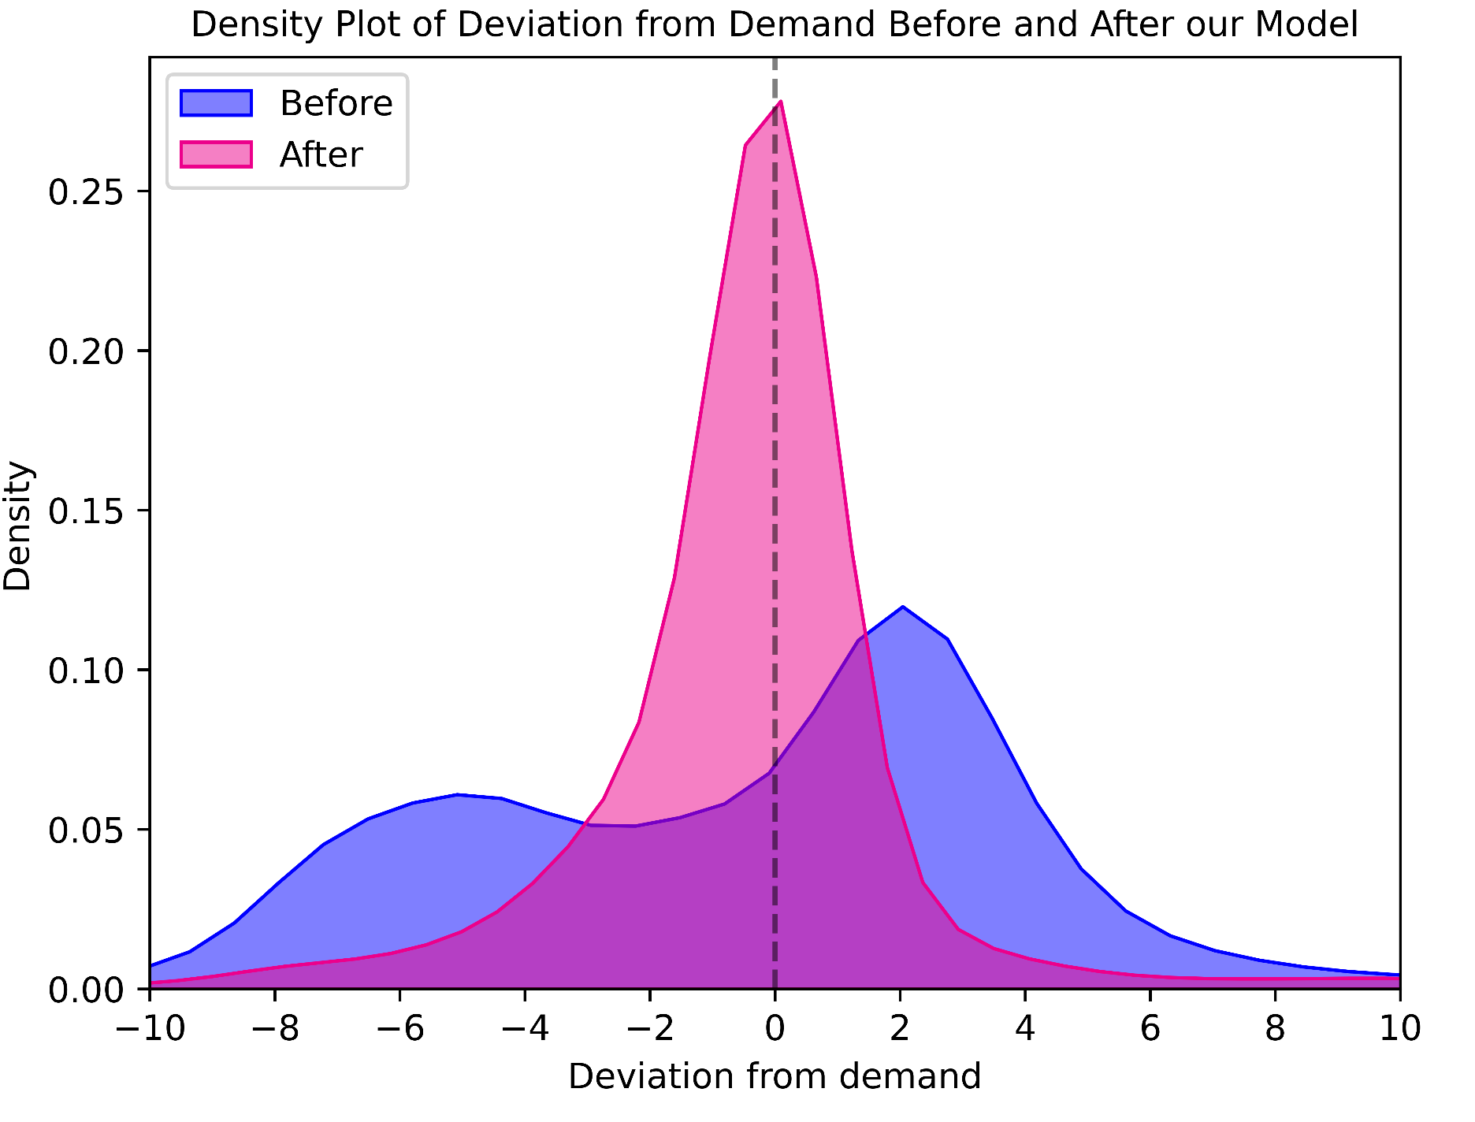
OPTIMIZED REDISTRIBUTION

Slide 10

OPTIMIZE PARCEL SIZE
Ensure each transport is utilized to its fullest
Average Parcel Size
11 Items

Slide 12


